Slide 1
Lecture 10: Multilevel modelling 2

Slide 2
The agenda for this lecture
Random intercept multilevel model
Random slope models
Some issues for MLMs
GOALS OF THIS LECTURE
To review and extend random intercept models
To introduce random slope models
To present some additional issues

Slide 3
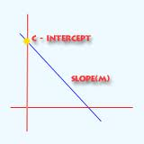

More on Random intercepts
Section 1: Lecture 10
A review of last lecture
Level 2 predictors
SPSS output

Slide 4
Hierarchical Linear Models Multilevel models
A two stage strategy to investigate variables at two levels of analysis.
Level 1: relationships among level 1 variables estimated separately for each higher level (level 2) unit.
These relationships are then used as outcome variables for the variables at level 2.

Slide 5
Example (Heck et al, 2011 – chap 3)
Students nested within schools
Dataset contains a number of variables including:
Maths test score (math)
Student socio-economic status (ses).
Average SES per school (ses_mean)
Percent of students who intend to study at “4-year universities” (per4yrc)
Type of school (public = 1 if public, 0 otherwise)
The goal is predict performance on the maths test

Slide 6
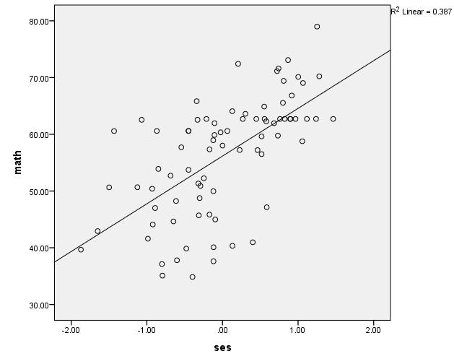
One regression model
Assumes the one model for all schools

Slide 7
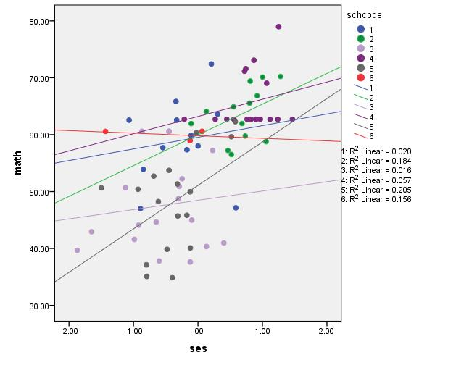
Regression models for each class
Different slopes
Different intercepts:
Multilevel models assume that these intercepts are normally distributed around a mean value
Different linear models for 6 different schools

Slide 8
Random intercept model Notation
Random intercept model treats the intercepts as random but has a fixed effect for slope.
j is an index for groups
i is an index for individuals within groups
Y_{ij} is the dependent or outcome variable
x_{ij} is a predictor variable at individual level
z_{j} is a predictor variable at group level

Slide 9
Random intercept model Equations
Random intercept model treats the intercepts as random but has a fixed effect for slope.
Level 1 equation: Y_{ij} = β_{0j} + β₁ x _{ij} + ε_{ij}
Level 2 equations: β_{0j} = γ₀₀ + γ₀₁ z _{j} + u_{0j}
β₁ = γ₁₀
So that Y_{ij} = γ₀₀ + γ₁₀ x _{ij} + γ₀₁ z _{j} + u_{0j} + ε_{ij}
Random intercept
Fixed slope
If we have no predictors x and z (ie set γ₁₀ = γ₀₁ = 0), then we have the random effects ANOVA – the null model
If we have no predictors z (ie set γ₀₁ = 0), then we have a random intercept model with only level 1 predictors – last lecture

Slide 10
Last lecture
Predict performance on the maths test from student SES
First we fitted a null model to check the variance components (i.e. calculate an ICC) to see if we needed a multilevel model.
Then we fitted a random intercept MLM with ses as the only predictor

Slide 11
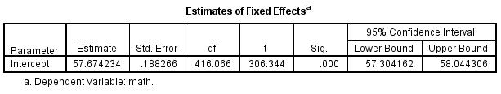
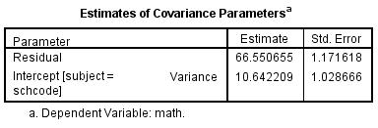
Output for null model
Random effects ANOVA:
Y_{ij} = γ₀₀ + u_{j} + ε_{ij}
ICC = [10.64/(10.64+66.55)] = 0.138

Slide 12
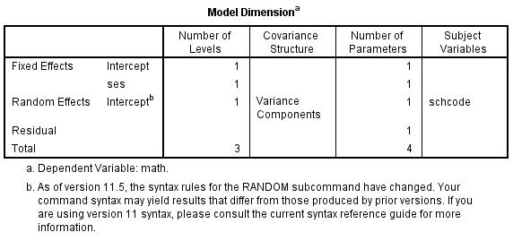
Output for random intercept model
Model dimension sets out the shape of the data.
Two fixed effects (the fixed intercept γ₀₀ and fixed slope for ses)
One random effect (the variance of the intercept u_{j} )
One residual effect
Four parameters: Y_{ij} = γ₀₀ + γ₁₀ (SES) _{ij} + u_{j} + ε_{ij}

Slide 13
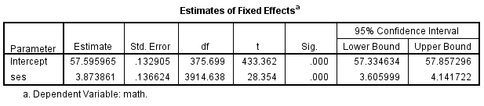
Output for random intercept model
Estimates for fixed effects:
Estimate for fixed intercept γ₀₀ = 57.60
Estimate for slope of ses, γ₁₀ = 3.87
Both are significant.
Four parameters: Y_{ij} = γ₀₀ + γ₁₀ (SES) _{ij} + u_{j} + ε_{ij}
Significant positive coefficient for ses predicting math

Slide 14
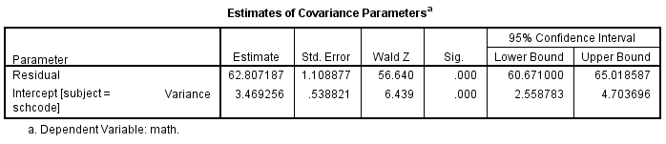
Output for random intercept model
Variance:
Previous intercept variance for null model = 10.64
Intercept variance for current model = 3.47
Reduction of variance from null model = (10.64-3.47)/10.64
= 67%
So SES accounts for 67% of between group variance
ICC = 3.47/(3.47+62.81) = 0.05 – much reduced compared to null model.

Slide 15
Today
We want to predict performance on the maths test from student SES as well as from school level variables:
Average SES per school (ses_mean)
Percent of students who intend to study at “4-year universities” (per4yrc)
Type of school (public = 1 if public, 0 otherwise)
We have already fitted a null model so we know we need a multilevel model.
Now we fit a random intercept MLM with both individual (student) and group (school) level predictors.

Slide 16
Random intercept model
Level 1 equation: Y_{ij} = β_{0j} + β₁ x _{ij} + ε_{ij}
Level 2 equations: β_{0j} = γ₀₀ + γ₀₁ z _{j} + u_{0j}
β₁ = γ₁₀
So that Y_{ij} = γ₀₀ + γ₁₀ x _{ij} + γ₀₁ z _{j} + u_{0j} + ε_{ij}
Level 1 equation:
math_{ij} = β_{0j} + β₁ ses _{ij} + ε_{ij}
Level 2 equations:
β_{0j} = γ₀₀ + γ₀₁ ses_mean _{j} + γ₀₂ per4yrc_{j} + γ₀₃ public_{j} + u_{0j}
β₁ = γ₁₀
So that
math_{ij} = γ₀₀ + γ₁₀ ses _{ij} + γ₀₁ ses_mean _{j} + γ₀₂ per4yrc_{j} + γ₀₃ public_{j} + u_{0j} + ε_{ij}

Slide 17
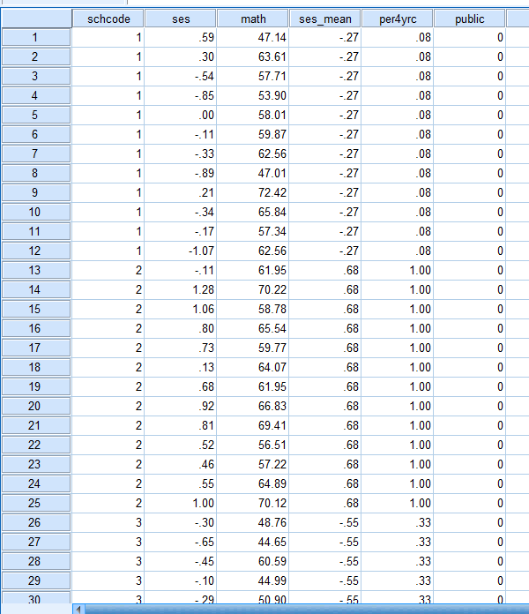
This is a merged datafile from various sources.
A student file with ses and math variables.
A school data file with per4yc and public variables.
ses_mean was produced by aggregation and added to the school datafile
The school level variables were disaggregated and merged into the student level file.
We saw how to do aggregation and disaggregation last lecture.

Slide 18
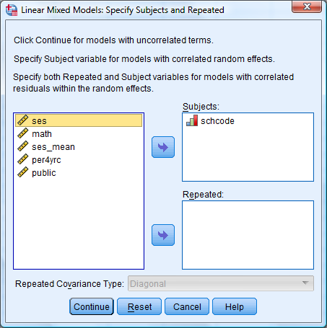
Random intercept model
Analyze -> Mixed Models -> Linear...
Cases grouped within school

Slide 19
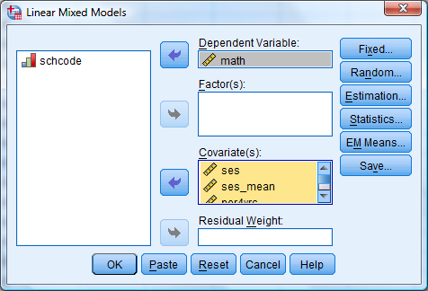
Random intercept model
Predicting math
from the predictor variables
Note here that public is treated as a covariate because it is a binary variable (i.e coded 0,1). Binary variables are OK in regressions but variables with three or more categories, as well as dichomotous variables coded (say) 1,2, would have to be treated as factors (a little bit more complicated – I prefer to use binary variables if I can.

Slide 20
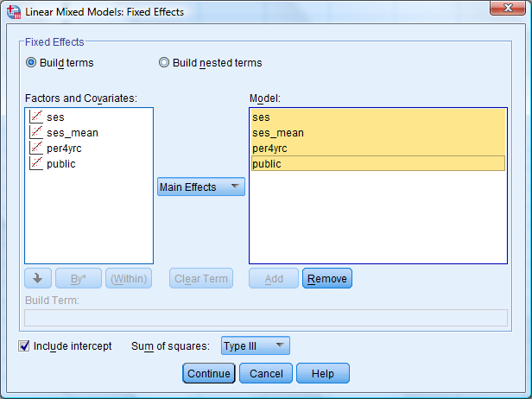
Random intercept model
Our predictors are all fixed Main effects

Slide 21
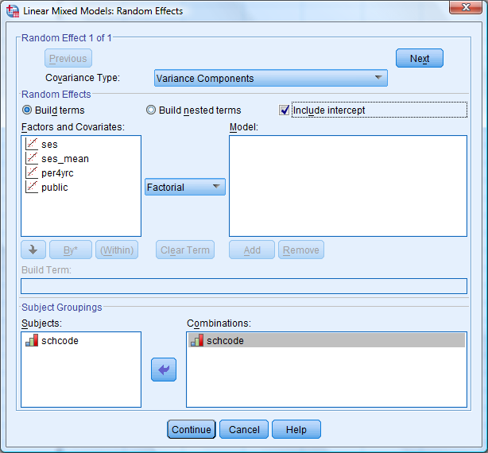
Random intercept model
Stick with variance components
Include an intercept
schcode is the grouping variable

Slide 22
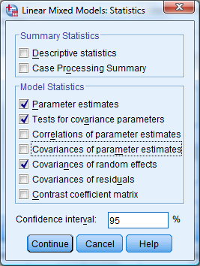
Random intercept model
Check that restricted maximum likelihood is used
Select at least these statistics

Slide 23

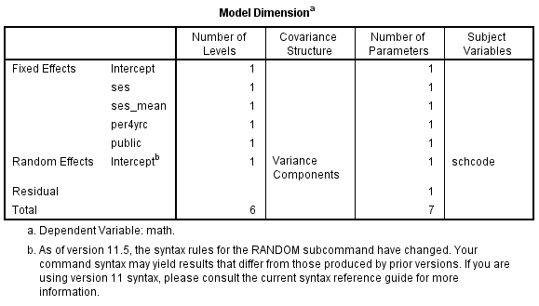
Output
Model dimension sets out the shape of the data.
Five fixed effects (the fixed intercept γ₀₀ and fixed slope for each predictor)
One random effect (the variance of the intercept u_{0j})
One residual effect (the variance of the error term ε_{ij})
Seven parameters:
math_{ij} = γ₀₀ + γ₁₀ ses _{ij} + γ₀₁ ses_mean _{j} + γ₀₂ per4yrc_{j} + γ₀₃ public_{j} + u_{0j} + ε_{ij}

Slide 24
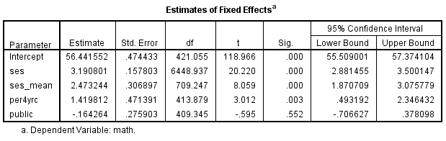
Output
Estimates for fixed effects:
Estimate for fixed intercept γ₀₀ = 56.44*
Estimate for slope of ses, γ₁₀ = 3.19*
of ses_mean, γ₀₁ = 2.47*
of per4yrc, γ₀₂ = 1.42*
of public, γ₀₃ = – 0.16
math_{ij} = γ₀₀ + γ₁₀ ses _{ij} + γ₀₁ ses_mean _{j} + γ₀₂ per4yrc_{j} + γ₀₃ public_{j} + u_{0j} + ε_{ij}

Slide 25
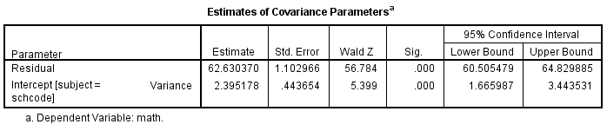
Output
Variance:
Previous intercept variance for null model = 10.64
Intercept variance for current model = 2.40
Reduction from null model = (10.64-2.40)/10.64 = 77%
So the predictors account for 77% of level 2 variance (between groups)
Residual (level 1) variance in null model = 66.55
Residual variance here = 62.63
Reduction from null model = (66.55-62.63)/66.55 = 6%
So, student SES accounts for 6% of level 1 variance in individual math performance.

Slide 26


Random slope models
Section 2: Lecture 10
Basic ideas
SPSS output
Predicting slopes
More SPSS output

Slide 27
Regression models for each class
Different slopes
Different intercepts:
Multilevel models assume that these intercepts are normally distributed around a mean value
Different slopes:
We can also fit MLMs that assume the slopes are normally distributed around a mean value
Different linear models for 6 different schools

Slide 28
Random slope model
Level 1 equation: Y_{ij} = β_{0j} + β_{1j} x _{ij} + ε_{ij}
Level 2 equations: β_{0j} = γ₀₀ + γ₀₁ z _{j} + u_{0j}
β_{1j} = γ₁₀ + u_{1j}
so that
Y_{ij} = (γ₀₀ + γ₀₁ z _{j} + u_{0j} )+ (γ₁₀ + u_{1j} )x _{ij} + ε_{ij}
Y_{ij} = γ₀₀ + γ₁₀ x _{ij} + γ₀₁ z _{j} + u_{0j} + u_{1j} x _{ij} + ε_{ij}
Level 1 equation:
math_{ij} = β_{0j} + β_{1j} ses _{ij} + ε_{ij}
Level 2 equations:
β_{0j} = γ₀₀ + γ₀₁ ses_mean _{j} + γ₀₂ per4yrc_{j} + γ₀₃ public_{j} + u_{0j}
β_{1j} = γ₁₀ + u_{1j}
So that
math_{ij} = γ₀₀ + γ₁₀ ses _{ij} + γ₀₁ ses_mean _{j} + γ₀₂ per4yrc_{j} + γ₀₃ public_{j} + u_{0j} + u_{1j} ses _{ij} + ε_{ij}

Slide 29
Random slope model
Level 1 equation:
math_{ij} = β_{0j} + β_{1j} ses _{ij} + ε_{ij}
Level 2 equations:
β_{0j} = γ₀₀ + γ₀₁ ses_mean _{j} + γ₀₂ per4yrc_{j} + γ₀₃ public_{j} + u_{0j}
β_{1j} = γ₁₀ + u_{1j}
So that
math_{ij} = γ₀₀ + γ₁₀ ses _{ij} + γ₀₁ ses_mean _{j} + γ₀₂ per4yrc_{j} + γ₀₃ public_{j} + u_{0j} + u_{1j} ses _{ij} + ε_{ij}
ses is now both a fixed effect (as before)
AND a random effect

Slide 30
Random slope model
Analyze -> Mixed Models -> Linear...
Cases grouped within school

Slide 31
Random slope model
Predicting math
from the predictor variables

Slide 32
Random slope model
Our predictors are all fixed Main effects

Slide 33
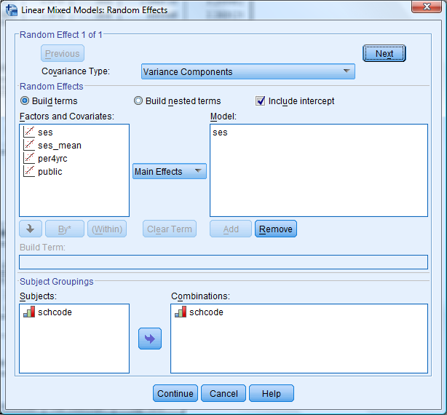
Random slope model
Now ses is a random effect

Slide 34
Why variance components?
The slopes could be correlated with the intercepts!
Variance components does not include a parameter for the correlation.
If you want to investigate whether the slopes and intercepts might be correlated, you can try “Unstructured”.
This does not impose any constraints on the random effects covariance matrix, whereas variance components assumes it is diagonal.
However, “unstructured” can result in warning messages about lack of convergence.
If you get one of these, drop some variables or go back to Variance components

Slide 35
Random slope model
Check that restricted maximum likelihood is used
Select at least these statistics

Slide 36
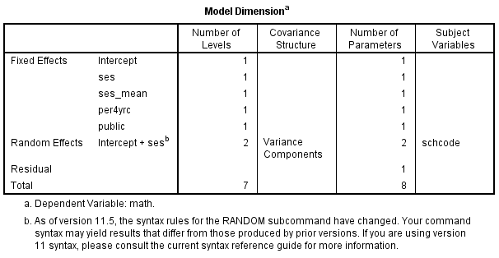
Output
Model dimension sets out the shape of the data.
Five fixed effects (the fixed intercept γ₀₀ and fixed slope for each predictor)
Two random effects
One residual effect
Eight parameters:
math_{ij} = γ₀₀ + γ₁₀ ses _{ij} + γ₀₁ ses_mean _{j} + γ₀₂ per4yrc_{j} + γ₀₃ public_{j} + u_{0j} + u_{1j} ses _{ij} + ε_{ij}

Slide 37
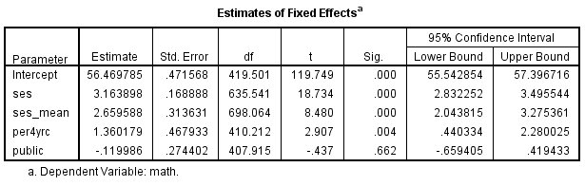
Output
Estimates for fixed effects:
Estimate for fixed intercept γ₀₀ = 56.47*
Estimate for slope of ses, γ₁₀ = 3.16*
of ses_mean, γ₀₁ = 2.66*
of per4yrc, γ₀₂ = 1.36*
of public γ₀₃ = – 0.12
math_{ij} = γ₀₀ + γ₁₀ ses _{ij} + γ₀₁ ses_mean _{j} + γ₀₂ per4yrc_{j} + γ₀₃ public_{j} + u_{0j} + u_{1j} ses _{ij} + ε_{ij}

Slide 38
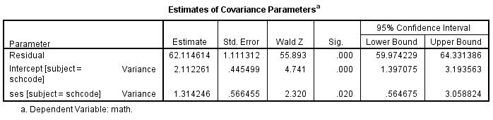
Output
Variance:
Much of the results here are as in the random intercept model, but now there is a significant slope variance of 1.31.
So we have evidence that the slopes vary across the schools in the sample.
Can we explain this variation?

Slide 39
More complex random slope models
Level 1 equation: Y_{ij} = β_{0j} + β_{1j} x _{ij} + ε_{ij}
Level 2 equations: β_{0j} = γ₀₀ + γ₀₁ z _{j} + u_{0j}
β_{1j} = γ₁₀ + u_{1j}

Slide 40
More complex random slope models
Level 1 equation: Y_{ij} = β_{0j} + β_{1j} x _{ij} + ε_{ij}
Level 2 equations: β_{0j} = γ₀₀ + γ₀₁ z _{j} + u_{0j}
β_{1j} = γ₁₀ + γ₁₁ z _{j} + u_{1j}
so that
Y_{ij} = (γ₀₀ + γ₀₁ z _{j} + u_{0j} )+ (γ₁₀ + γ₁₁ z _{j} + u_{1j} )x _{ij} + ε_{ij}
= γ₀₀ + γ₁₀ x _{ij} + γ₀₁ z _{j} + γ₁₁ z _{j} x _{ij} + u_{0j} + u_{1j} x _{ij} + ε_{ij}
A fixed effect that is the interaction of the group and individual effects
So that
math_{ij} = γ₀₀ + γ₁₀ ses _{ij} + γ₀₁ ses_mean _{j} + γ₀₂ per4yrc_{j} + γ₀₃ public_{j} +
+ γ₁₁ (ses_mean *ses) + γ₁₂ (per4yrc *ses) + γ₁₃ (public*ses) +
+ u_{0j} + u_{1j} ses _{ij} + ε_{ij}

Slide 41
Before we had ...
Our predictors are all fixed Main effects

Slide 42
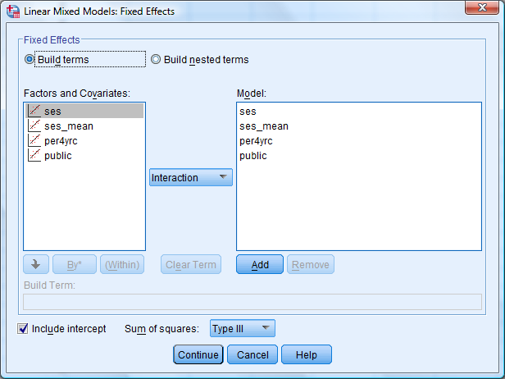
Now we want ...

Slide 43
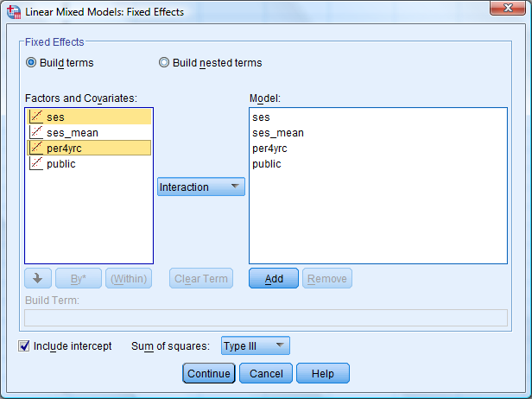
Now we want ...
Select two variables that are used in the interaction (Use the Ctrl key if need be).
Then Add...

Slide 44
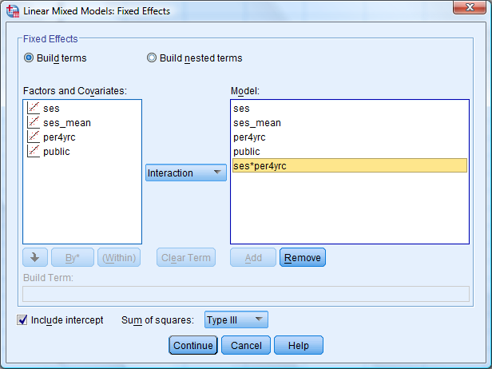
Now we want ...
Keep going until you have all the interactions you need.

Slide 45
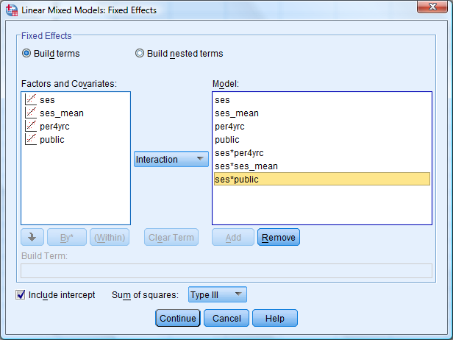
Now we want ...
math_{ij} = γ₀₀ + γ₁₀ ses _{ij} + γ₀₁ ses_mean _{j} + γ₀₂ per4yrc_{j} + γ₀₃ public_{j} +
+ γ₁₁ (ses_mean *ses) + γ₁₂ (per4yrc *ses) + γ₁₃ (public*ses) +
+ u_{0j} + u_{1j} ses _{ij} + ε_{ij}

Slide 46
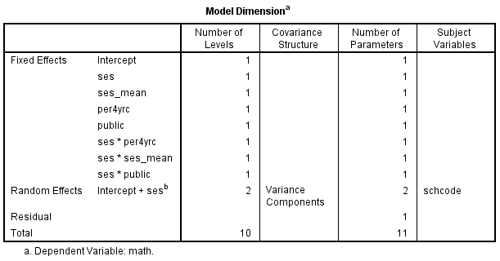
Output
Model dimension sets out the shape of the data.
It’s the same as before EXCEPT that now we have the three interaction effects.
Eleven parameters:
math_{ij} = γ₀₀ + γ₁₀ ses _{ij} + γ₀₁ ses_mean _{j} + γ₀₂ per4yrc_{j} + γ₀₃ public_{j} +
+ γ₁₁ (ses_mean *ses) + γ₁₂ (per4yrc *ses) + γ₁₃ (public*ses) +
+ u_{0j} + u_{1j} ses _{ij} + ε_{ij}

Slide 47
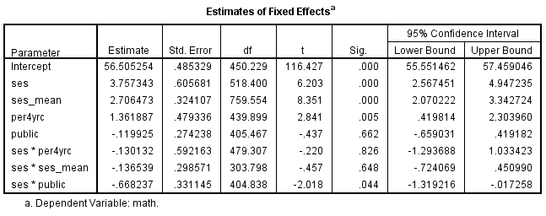
Output
Estimates for fixed effects:
Same significant main effects as before, but only one significant interaction – ses*public
We can remove the non-significant interactions for a more parsimonious model

Slide 48
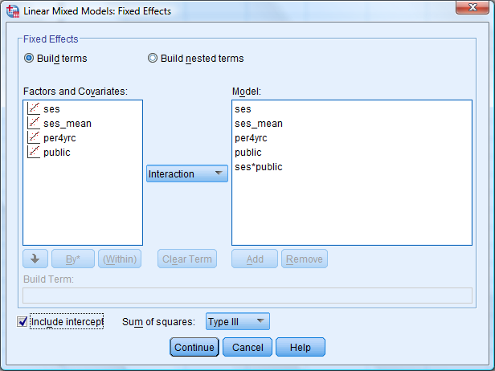
Simpler model
math_{ij} = γ₀₀ + γ₁₀ ses _{ij} + γ₀₁ ses_mean _{j} + γ₀₂ per4yrc_{j} + γ₀₃ public_{j} +
+ γ₁₃ (public*ses) +
+ u_{0j} + u_{1j} ses _{ij} + ε_{ij}

Slide 49
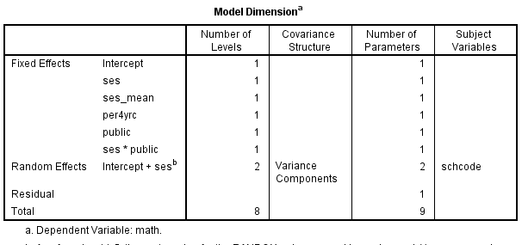
Output 2
Model dimension sets out the shape of the data.
Nine parameters:
math_{ij} = γ₀₀ + γ₁₀ ses _{ij} + γ₀₁ ses_mean _{j} + γ₀₂ per4yrc_{j} + γ₀₃ public_{j} +
+ γ₁₃ (public*ses) +
+ u_{0j} + u_{1j} ses _{ij} + ε_{ij}

Slide 50
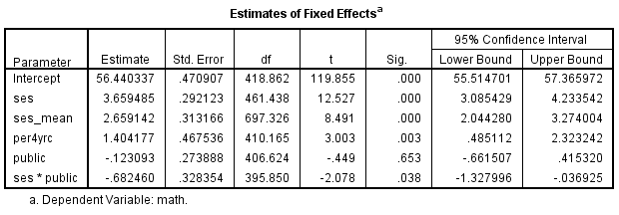
Output 2
Estimates for fixed effects:
Same significant main effects as before, and a significant slope effect for public, estimated at – 0.68.
Remember public = 1 indicates a public school.
So, the slope is lower for public schools.
Higher SES students in public schools get lower marks
Lower SES students in public schools get higher marks

Slide 51
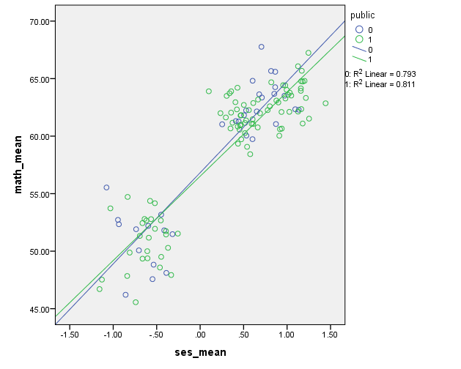
At school level Extreme school performance

Slide 52
At individual level
Higher SES kids expected to perform worse in public schools
Lower SES kids expected to perform better in public schools

Slide 53
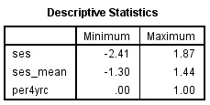
Interpreting the results
Fixed effects in the model
math = 56.4 + 3.7 ses + 2.7 ses_mean + 1.4 per4yrc – 0.12 public – 0.68 (public*ses)
Overall, estimated average performance on the test is 56.4.
Suppose everything else is equal:
Compare two students from lowest and highest ses-mean school:
Expected difference in scores = 2.7 X 1.44 – 2.7 X (-1.3) = 7.4
Two students from lowest and highest per4yrc schools
Expected difference in scores = 1.4 X 1.0 – 1.4 X (0) = 1.4
Two students with lowest and highest ses scores
Both in public school
3.7 X 1.87 – 0.68 X 1.87 – [3.7X (-2.41) – 0.68 X (-2.41)] = 12.9
Both in private school
3.7 X 1.87 – 3.7X (-2.41) = 15.8

Slide 54
Summary of results
The final model suggests the following effects
Student maths performance:
is positively predicted by student Socio Economic Status
and positively predicted by average SES of the school
as well as by the percentage of students in the school with ambitions towards obtaining more prestigious tertiary degrees
(as measured by intention to attend universities with a 4 year undergraduate program)
The significant random slope effect suggests that higher SES students will perform better in non-public schools and that lower SES students will perform better in public schools.

Slide 55
Additional issues
Section 3: Lecture 10
Centring
Assumptions
Estimation
Covariance structures

Slide 56
Additional issues for MLM
Centring: It is often recommended that continuous predictors in MLMs be mean-centred, especially if they are going to appear in an interaction.
Grand mean centring: Compute a new variable by subtracting the overall mean from it.
Group mean centring: Compute a new variable by subtracting the group mean from it.
(You can do this by calculating the group mean for each group – see last week, re aggregation – and then subtract one variable from the other.)
One point of centring is easier interpretation. A zero score is then the mean value.

Slide 57
Additional issues for MLM
Assumptions: (Pretty much) all the assumptions of regression still apply. Additionally, the random effects are assumed normally distributed.
Estimation: In the examples we have used Restricted maximum likelihood (REML), rather than maximum likelihood (ML). In most circumstances this won’t make much difference, but ML needs to be used if you are going to compare fit across different models.
Covariance structures: In this and previous lectures, we have not looked closely at different covariance structures for the random effects.
In effect we have assumed that the random effects are uncorrelated with each other. This may not be the case.
If you are using MLMs for your own research, you may need to consider this. Check out Field, 2009, p. 737, or Heck et al, p. 94.

Slide 58


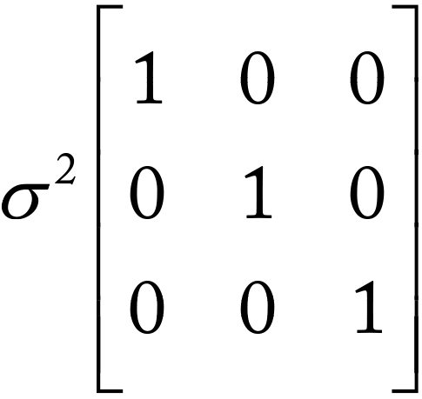
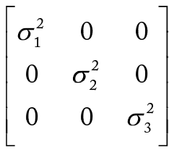


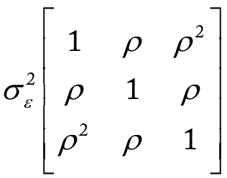
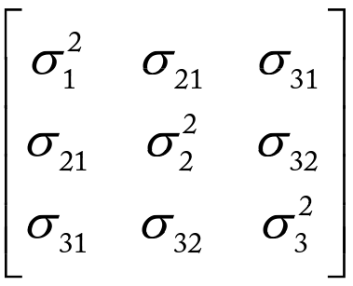
Additional issues for MLM
Covariance structures: 4 popular flavours (of 17 offered by SPSS)
Variance components
Diagonal
AR1 – autoregressive
Unstructured

Slide 59
Summary
IN THIS LECTURE, you
extended knowledge of random intercept models from the previous lecture
learnt about random slope models
learnt how to fit these models in SPSS
were provided with summary information on some additional issues

